Slide 1
Introduction to `dplyr` package in R for exploratory data analysis
Rahul Sangole
Machine Data Analytics
Connected Solutions Organization
Mar 31 2017

Slide 2
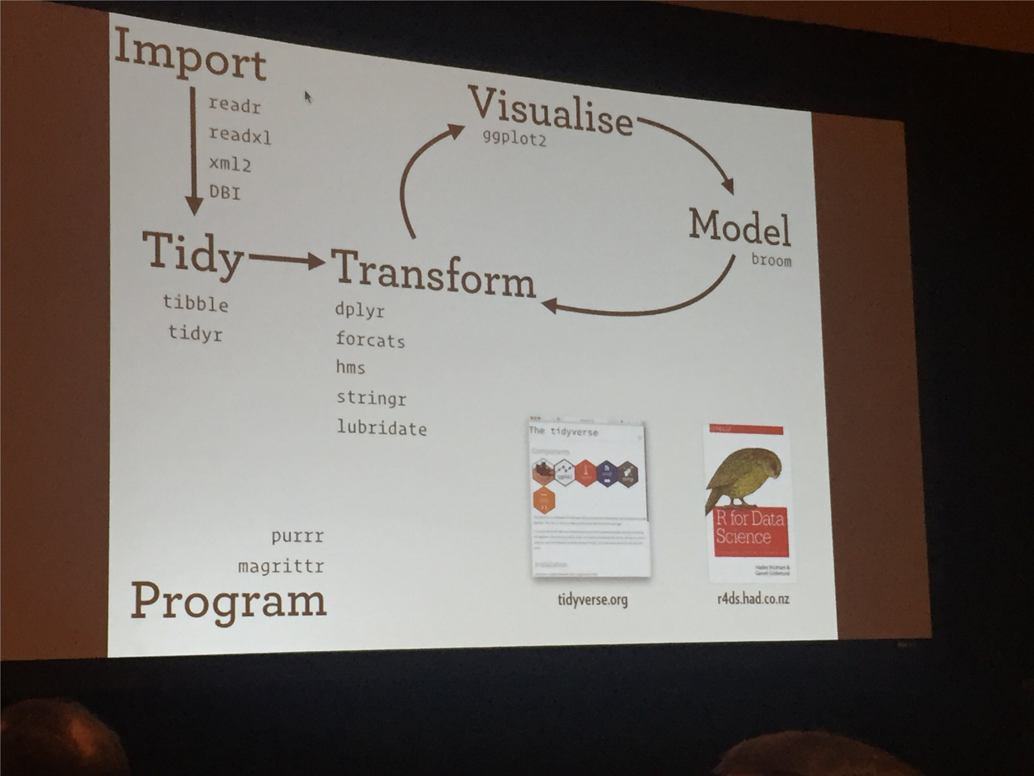
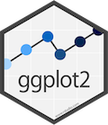

What’s covered today?
http://r4ds.had.co.nz/
http://tidyverse.org/

Slide 3


Objective for today

Slide 4



What’s not covered today?

Slide 5
Take This
%>%
Do something with it

Slide 6
Other Resources
https://www.rstudio.com/wp-content/uploads/2015/02/data-wrangling-cheatsheet.pdf
https://cran.r-project.org/web/packages/dplyr/vignettes/introduction.html
https://www.youtube.com/watch?v=8SGif63VW6E

Slide 7


